Slide 1



Meal Patterns
&
Offer Versus Serve
Notes:
Hello Everybody my name is Alicia Corral Food Service Training Specialist I want to welcome you to meal patterns and offer versus serve training. In this training we will be discussing meal patterns, offer versus serve, and menus for our breakfast and lunch programs. Let's go ahead and get started.

Slide 2
Table of Contents
Chapter 1: Meal Patterns
Chapter 2: Offer Versus Serve
Chapter 3: The Menu
Chapter 4: Tips for Reading
The Menu

Slide 3
Chapter 1
Meal Patterns
Notes:
The first topic we will be covering is meal patterns and why it is important to follow these meal patterns. All school meal programs are required follow meal patterns and dietary specifications established by the U.S. Department of Agriculture (USDA). The nutrition team creates Café LA’s menus based off these meal patterns to ensure students receive the correct amount of nutrients and micronutrients.

Slide 4
LAUSD Meal Programs
School Breakfast Program - SBP
National School Lunch Program - NSLP
Breakfast in the Classroom
Cafeteria Service
Grab N Go
Lunch K-12
Summer Food Services Program –SFSP & SSO
Summer Feeding Program
Notes:
Read: LAUSD provides nutritious meals to students of all grade levels through a variety of different food programs. Elementary, and secondary students follow the SBP meal pattern for breakfast, including BIC and Grab N Go. Lunch programs grades K-12 follow the NSLP meal pattern. The Supper and Summer Food Service Program (SFSP) and SSO follows the CACFP meal pattern and uses the meal pattern and portion size according to age.

Slide 5





Meal Components
Notes:
TELL: The meal patterns are made up of 5 different components. As we go over the meal patterns these are the meal components you will see. Meat/Meat Alternative is protein such 1 oz. of cooked chicken meat, ½ cup of yogurt, ¼ cup of beans, or 1 oz of cheddar cheese. Examples of grains Café LA serves would be a 1 oz whole grain tortilla, 1 oz of whole grain cereal, a 1 oz dinner roll or ½ cup of cooked brown rice. Vegetables are served fresh, cooked, canned, frozen, and 100% juice. Fruits are served either fresh, canned, frozen, dried or 100% juice. Whether fruits and vegetables are fresh or frozen they must be a ½ cup to be considered reimbursable.

Slide 6
Breakfast Meal
Pattern
K-12 BREAKFAST
DAILY REQUIREMENT | GRADES K-5 | GRADES 6-12
GRAIN, OZ. EQV. OR GRAIN & MEAT/MEAT ALT, OZ. EQV. | 2 | 2
FRUIT, CUP | 1 | 1
MILK | 8 FL OZ | 8 FL OZ
Notes:
Tell: The breakfast meal pattern is followed by the School Breakfast Program (SBP). Grades K-12 each follow the requirements for each age group to be in compliance of serving the correct nutrients and micronutrients for the week.

Slide 7
Lunch Meal Pattern
K-12 LUNCH
DAILY REQUIREMENT | GRADES K-5 | GRADES 6-12
GRAIN, OZ. EQV. | 2 | 2
MEAT/MEAT ALT, OZ. EQV. | 2 | 2
FRUIT, CUP | ½ | 1
*VEGETABLE, CUP | 1 | 1
MILK | 8 FL OZ | 8 FL OZ
FRUIT & VEGETABLE JUICE | GRADES K-5 | GRADES 6-12
VEGETABLE JUICE | No more than ½ of vegetable offerings may be in the form of juice | No more than ½ of vegetable offerings may be in the form of juice.
FRUIT JUICE | No more than ½ of fruit offerings may be in the form of juice | No more than ½ of fruit offerings may be in the form of juice.
Notes:
TELL: As you can see the NSLP meal pattern has requirements for 3 grade levels. There are daily and weekly requirements for fruits, grain and milk.
Calories, saturated fat and sodium are averaged over a 5-day week. This allows some days to be higher or lower in these nutrients as long as the 5-day average meets the daily requirements. The LAUSD lunch menu is designed to meet the NSLP meal pattern for both daily and weekly requirements.

Slide 8
Vegetables Requirements
The meal pattern for the National School Lunch Program requires a minimum weekly offering of vegetables from each vegetable subgroup category.
*VEGETABLE SUB GROUP WEEKLY REQUIREMENT | GRADES K-5* (3-3/4 CUP WEEKLY) | GRADES 6-12 (3-3/4 CUP WEEKLY)
DARK GREEN | 1/2 | 1/2
RED/ORANGE | 1 | 1-1/2
STARCHY | 1/2 | 1/2
LEGUME | 1/2 | 1/2
OTHER | 1-1/4 | 2
Notes:
TELL: The NSLP requires the grouping of vegetables into subgroups. Vegetables from each subgroup must be served each week.
The vegetable subgroups were established to encourage children to eat a variety of different vegetables, as recommended by the Dietary Guidelines for Americans. Vegetables from any of the subgroups can be offered in the “additional to reach weekly total” requirement. As long as you follow the menu, you will be in compliance in serving the correct types and amounts of the different vegetable subgroups.

Slide 9

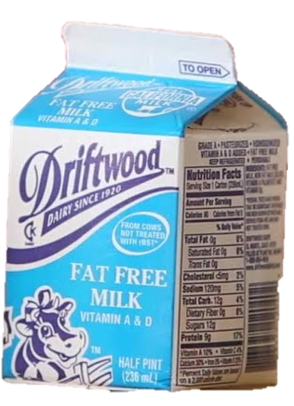
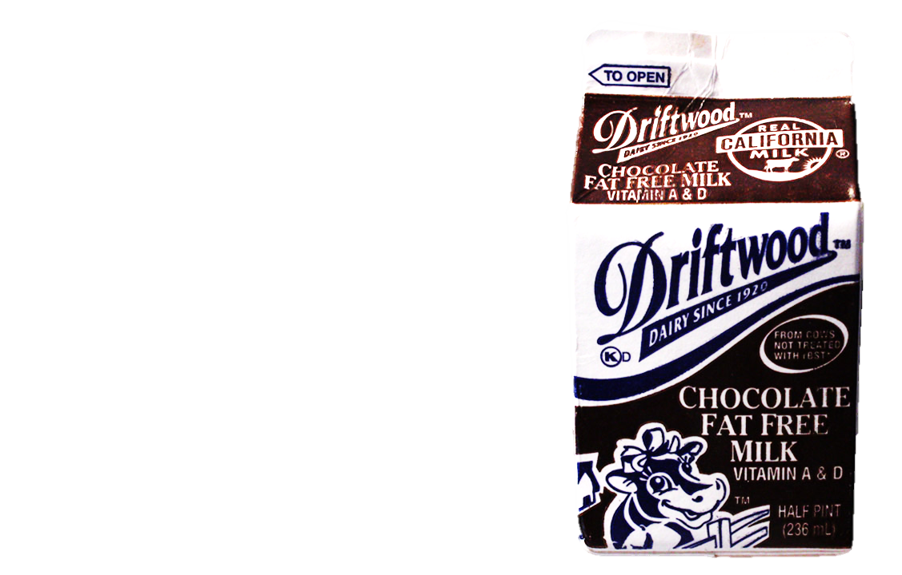
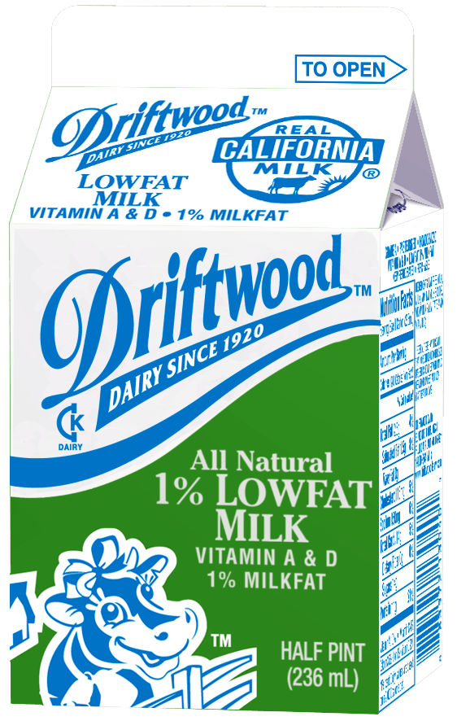
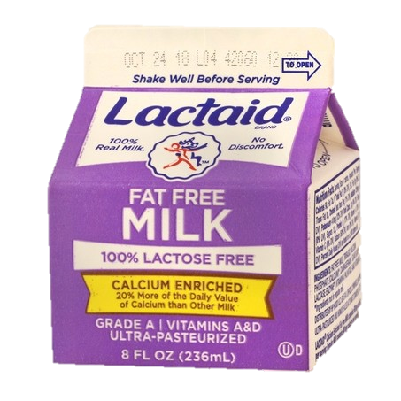
Milk unit of measurement: Cups
At least two options must be offered. One milk choice must be unflavored.
Flavored milk is not offered during breakfast.
  1% Milk
  (Unflavored)
  Non-Fat (Unflavored)
Fat Free
Chocolate Milk
(Ages 6 and older)
Fat Free, Lactose-Free Milk
(Unflavored)
Notes:
Fluid milk is required in all of the Child Nutrition Programs (CNP) including School Breakfast Program (SBP), National School Lunch Program (NSLP). Two types of milk must be offered during service.

Slide 10
Chapter 2
Offer Versus Serve

Slide 11
Offer Versus Serve Tip Sheet
K-12 BREAKFAST
MUST OFFER THESE FOOD ITEMS: FOOD ITEM/MAIN ITEM #1 FOOD ITEM/MAIN ITEM #2 FOOD ITEM/MAIN ITEM #3 (VEGAN)* FRUIT FRUIT JUICE MILK** | STUDENTS MUST TAKE 3 POINTS: Take no more than 1 food/main item One item must be fruit or juice
K-12 LUNCH
MUST OFFER MINIMUM REQUIRED AMOUNTS OF ALL 5 FOOD COMPONENTS: GRAIN MEAT/MEAT ALTERNATE VEGETABLE FRUIT MILK* | STUDENT MUST TAKE 3 COMPONENTS: 1 of the 3 components must be ½ cup fruit or ½ cup vegetable
*FOOD ITEM/MAIN ITEM #3 (VEGAN)
Offer a variety of vegan breakfast food items/main items throughout the week
Notes:
School Breakfast Program refers to the entrée as a food item no matter what you call it it is the same thing food item main item this is how it will be referenced on the menu.

Slide 12
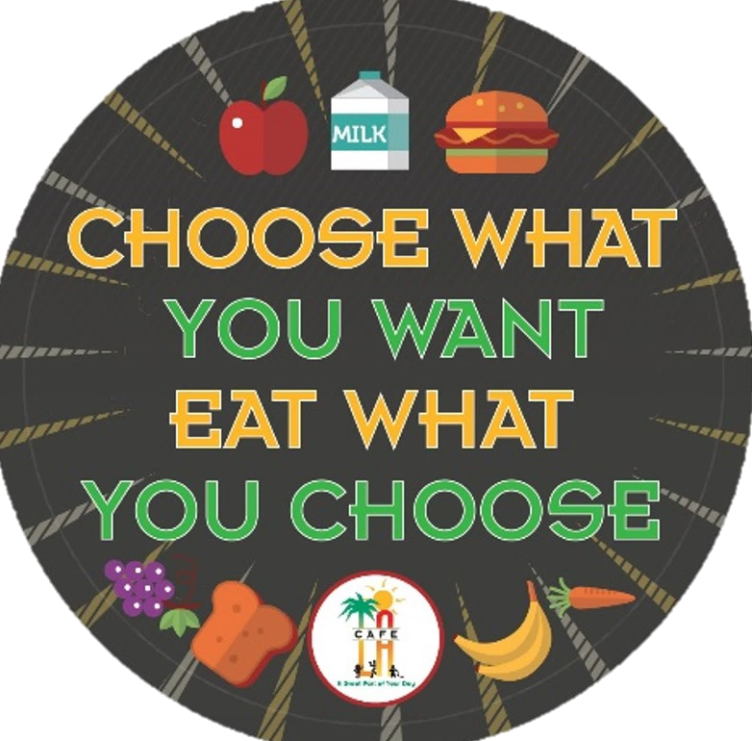
Offer Versus Serve
Offer Versus Serve (OVS) allows students to decline some of the food items offered in the school meal programs.
OVS guidelines are to be followed during:
  Breakfast service under SBP
  Lunch service under NSLP
Notes:
Studies show that giving the student the choice to choose what they eat increases participation. Just like us we go to a restaurant we want to choose what we are going to eat not be told we only have one choice.

Slide 13
FOOD ITEM
COMPONENT
A food item is a specific food offered that contains one or more food components.
A component is one of the food groups offered in a reimbursable meal.
Notes:
TELL: What is the difference between a food item and a component? A FOOD ITEM is a specific food offered that contains one or more food components. A COMPONENT is one of the food groups offered in a reimbursable meal. Lets talk more about that.

Slide 14
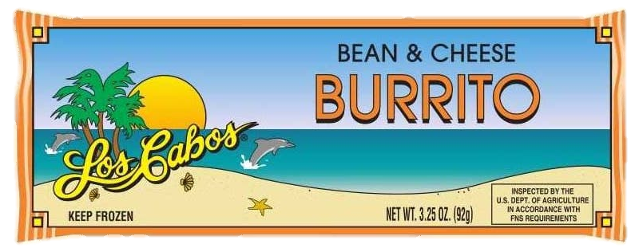
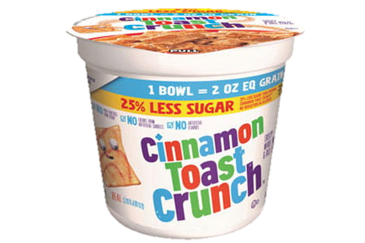

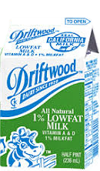
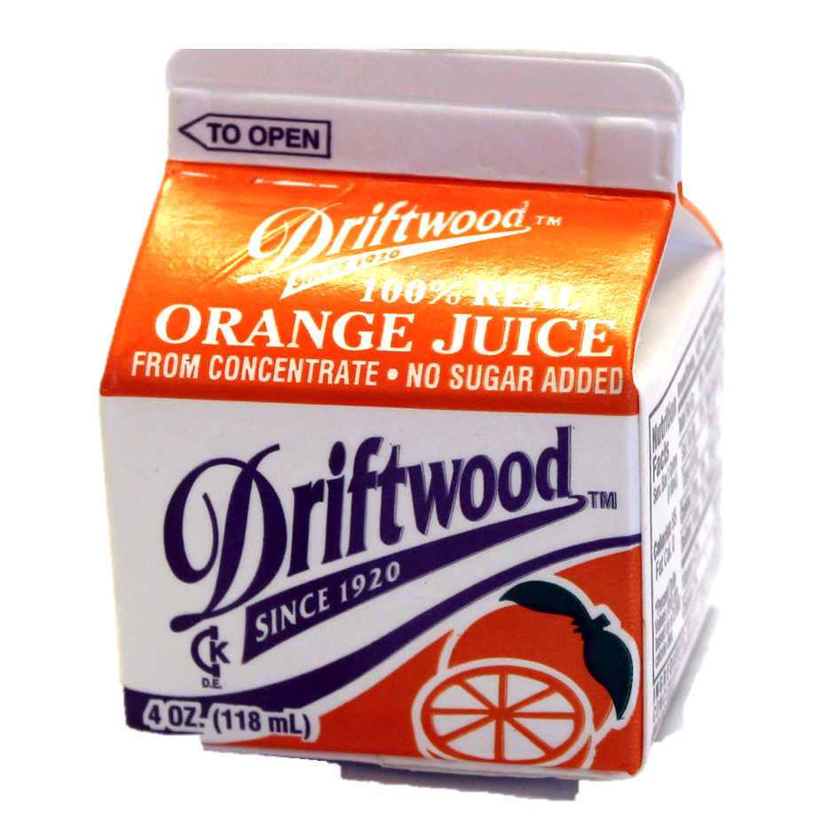
Items
Breakfast
Lunch
Components
Notes:
TELL: For breakfast service, we refer to the food served as each food item. During lunch service, we will identify the food served as components. There can be 1 or more components in a food item.

Slide 15
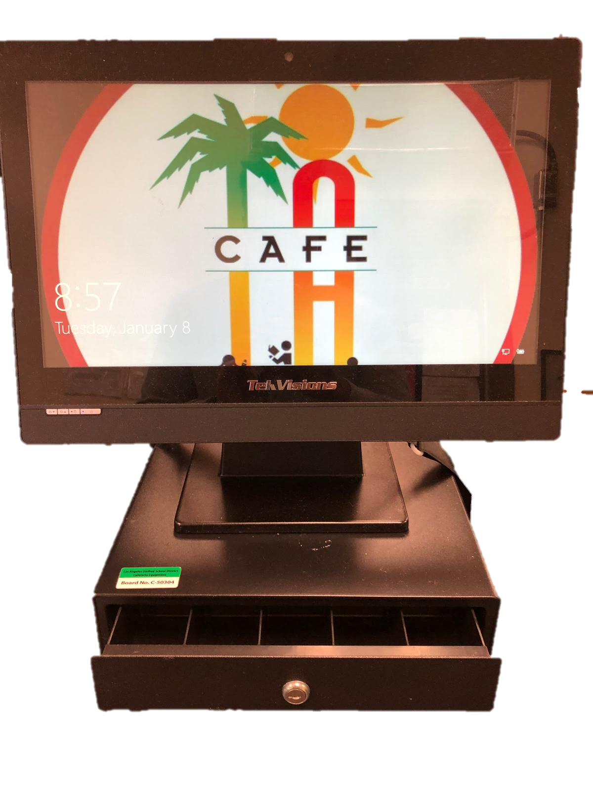

Point of Service
Point of Service (POS) is when a determination can be made that all meal components have been offered and a reimbursable meal has been served to an eligible child.
  This procedure is the same for breakfast and lunch and occurs at the end of the serving line.
  Breakfast - POS or 5 Day Breakfast Meal Count Form
  Lunch- POS or Rosters
Notes:
TELL: The Point of Service is the point in the foodservice operation where a determination can accurately be made that a reimbursable meal has been served to an eligible child. This normally occurs at the end of the serving line. This procedure is the same for breakfast and lunch. For breakfast, mark the students off on the roster and for lunch, the POS or rosters. The POS is done at the end of the serving line after it has been verified that the student has taken a reimbursable meal. There are no exceptions.

Slide 16
Ensuring All Meals Are Reimbursable
In order for reimbursable meals to be claimed during service, all food items must be offered and available for every student.
Items that run out during meal service, must be immediately replenished or replaced with a suitable substitution in order for the meals to be reimbursable
If an item runs out during service, all students who take a complete meal after that point cannot be claimed as reimbursable until that item is replaced
Notes:
As I just mentioned claiming a meal in the POS happens at the end of the service line after a reimbursable meal has been claimed. 5 components must be offered 3 components must be taken 1 must be a fruit or vegetable. From the start of service to the end of service every single student that passes through your line must be offered 5 components. At any point during service any component runs out you must stop the line and replenish that component with the same or an equal item. Having a back up plan to substitute any items, communicating with team members and manager, and reading the meal contribution list will make this process easier.

Slide 17

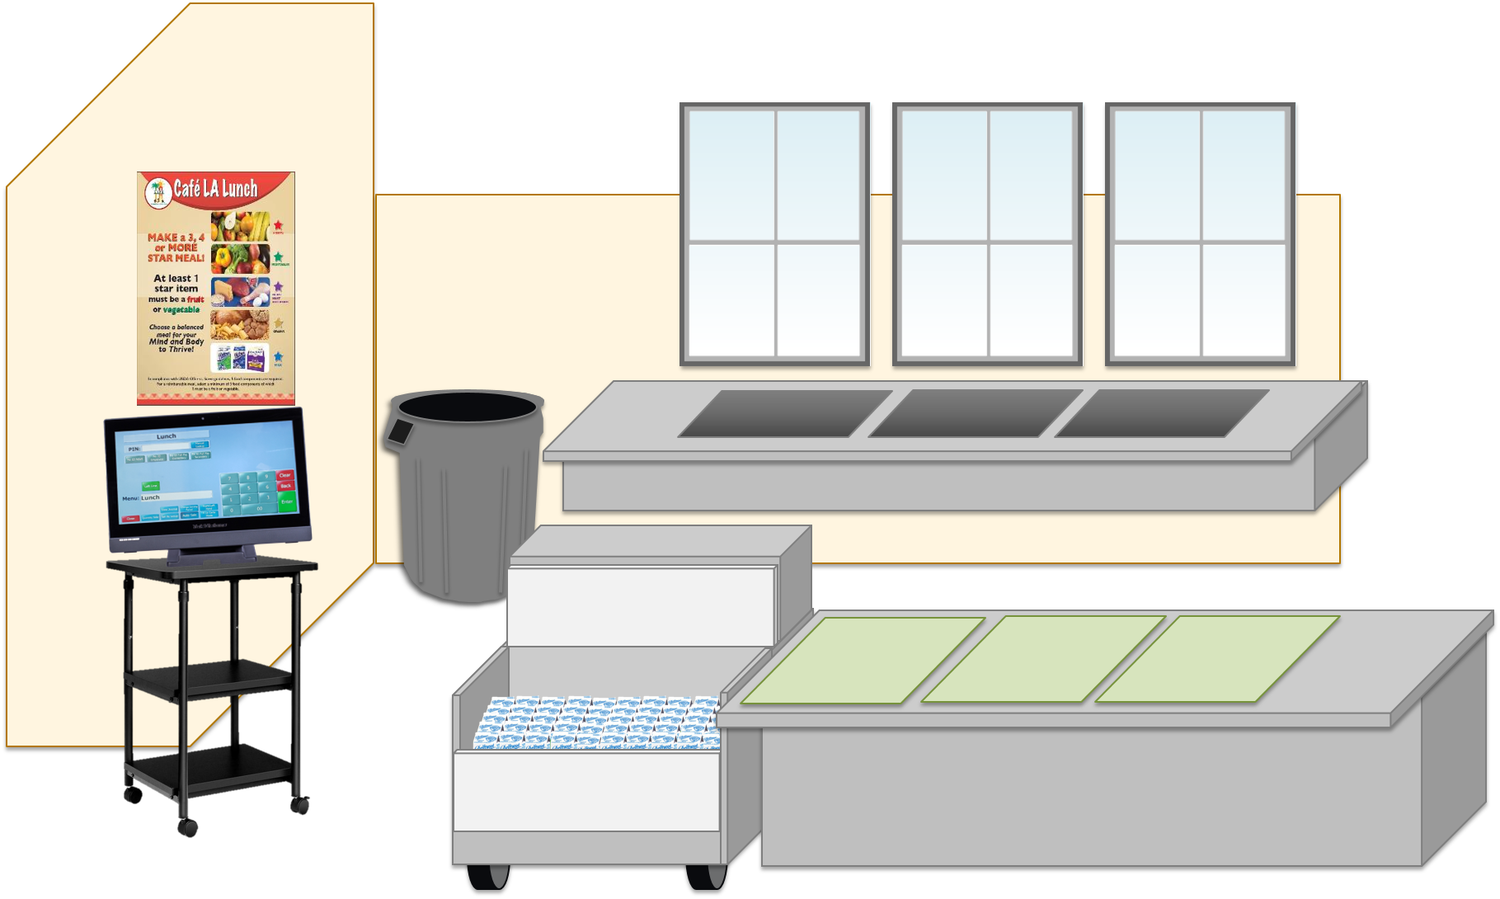





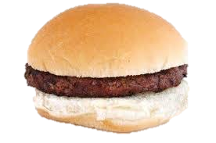
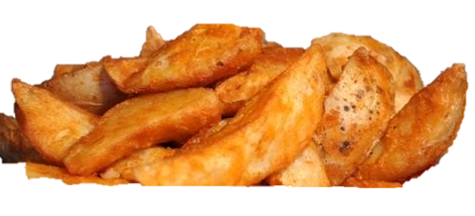
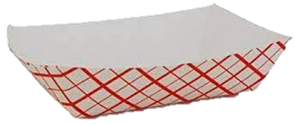

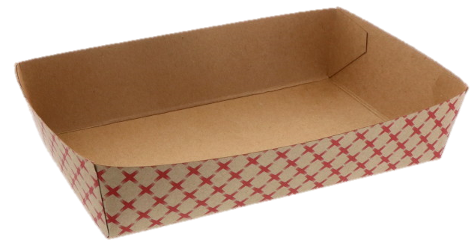
Student comes through the line and selects their lunch.
The student takes the last apple on the serving line. Until that fruit is replenished, every meal taken after that point is not considered reimbursable, as all items were not offered.

Slide 18



The next student selects their lunch items.
Though the student took a complete meal, the fruit was not offered and the meal cannot be claimed for reimbursement. Before service continues, fruit must be replenished.

Slide 19

Once the apples are replenished, the meals can once again be claimed as reimbursable.

Slide 20



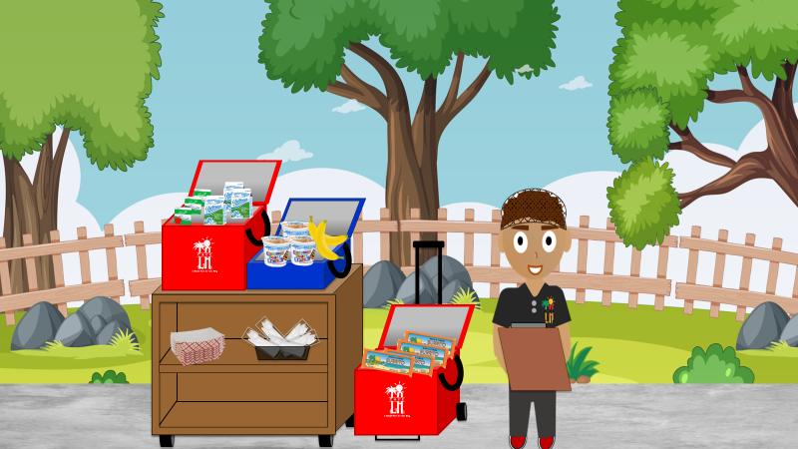
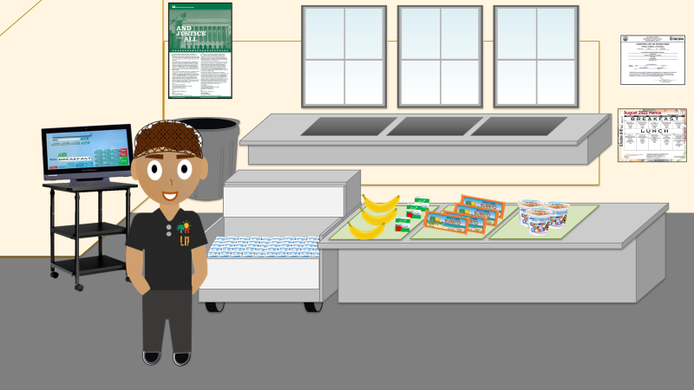
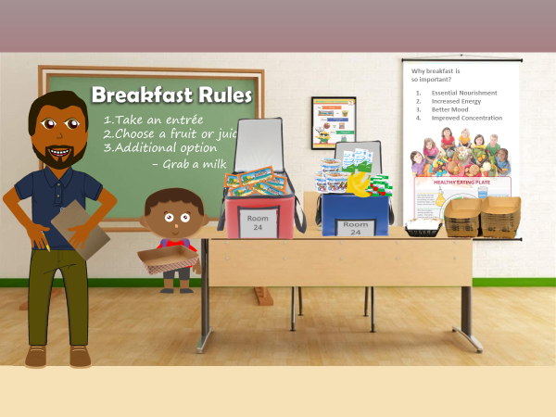
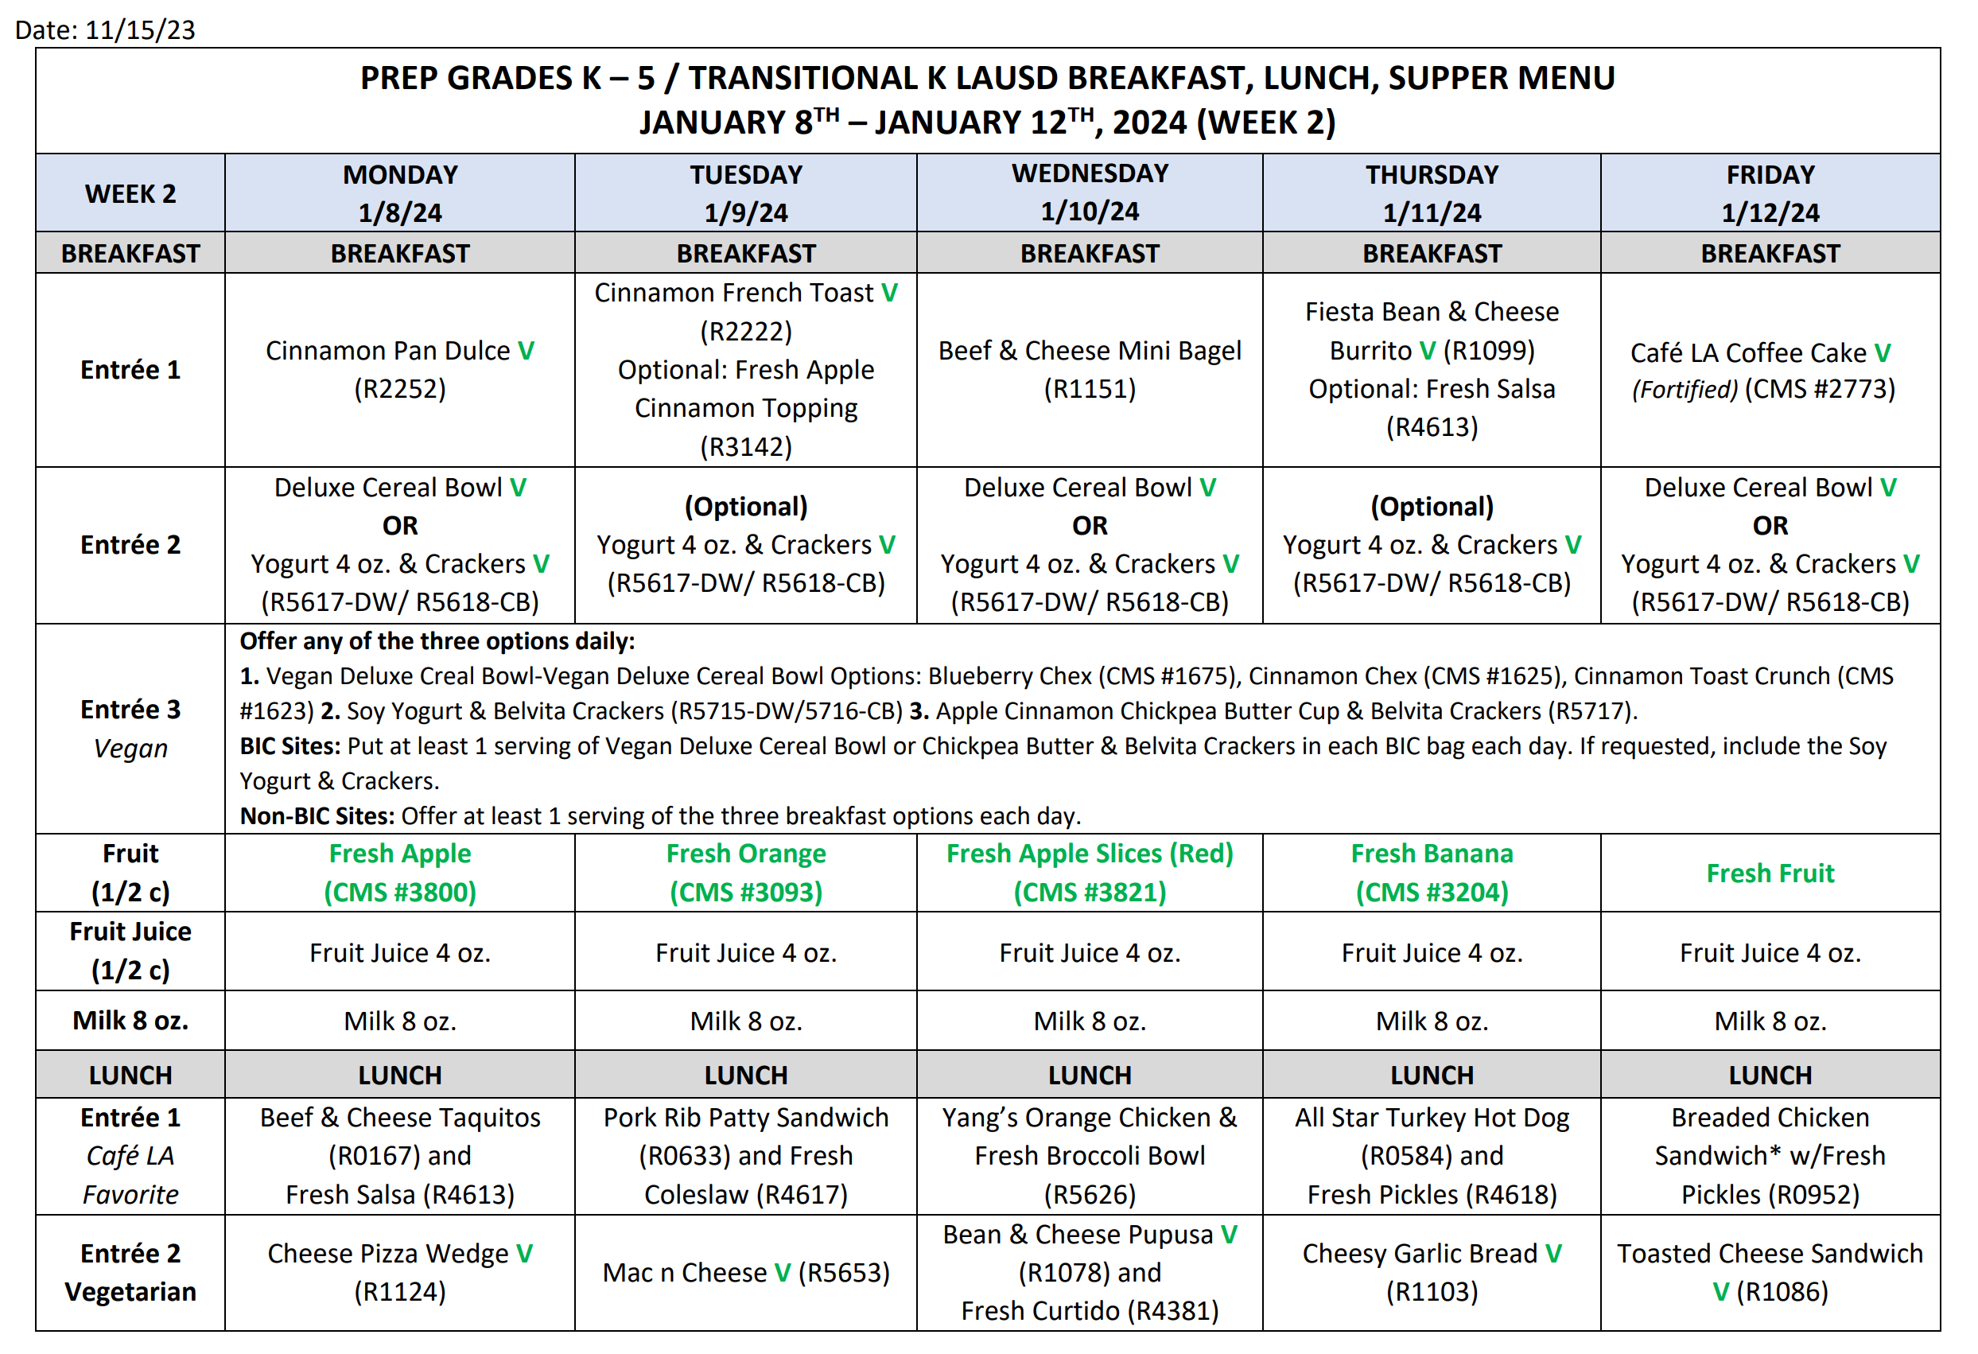
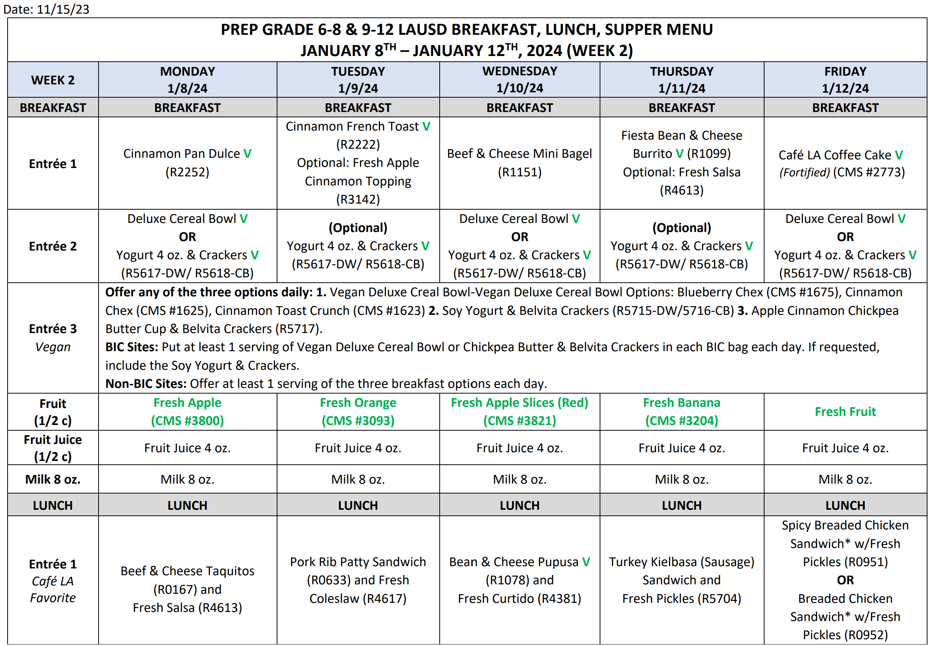
Breakfast OVS
Rules
Cafeteria Breakfast Service
Breakfast Cart Service
Breakfast In The Classroom (BIC)

Slide 21
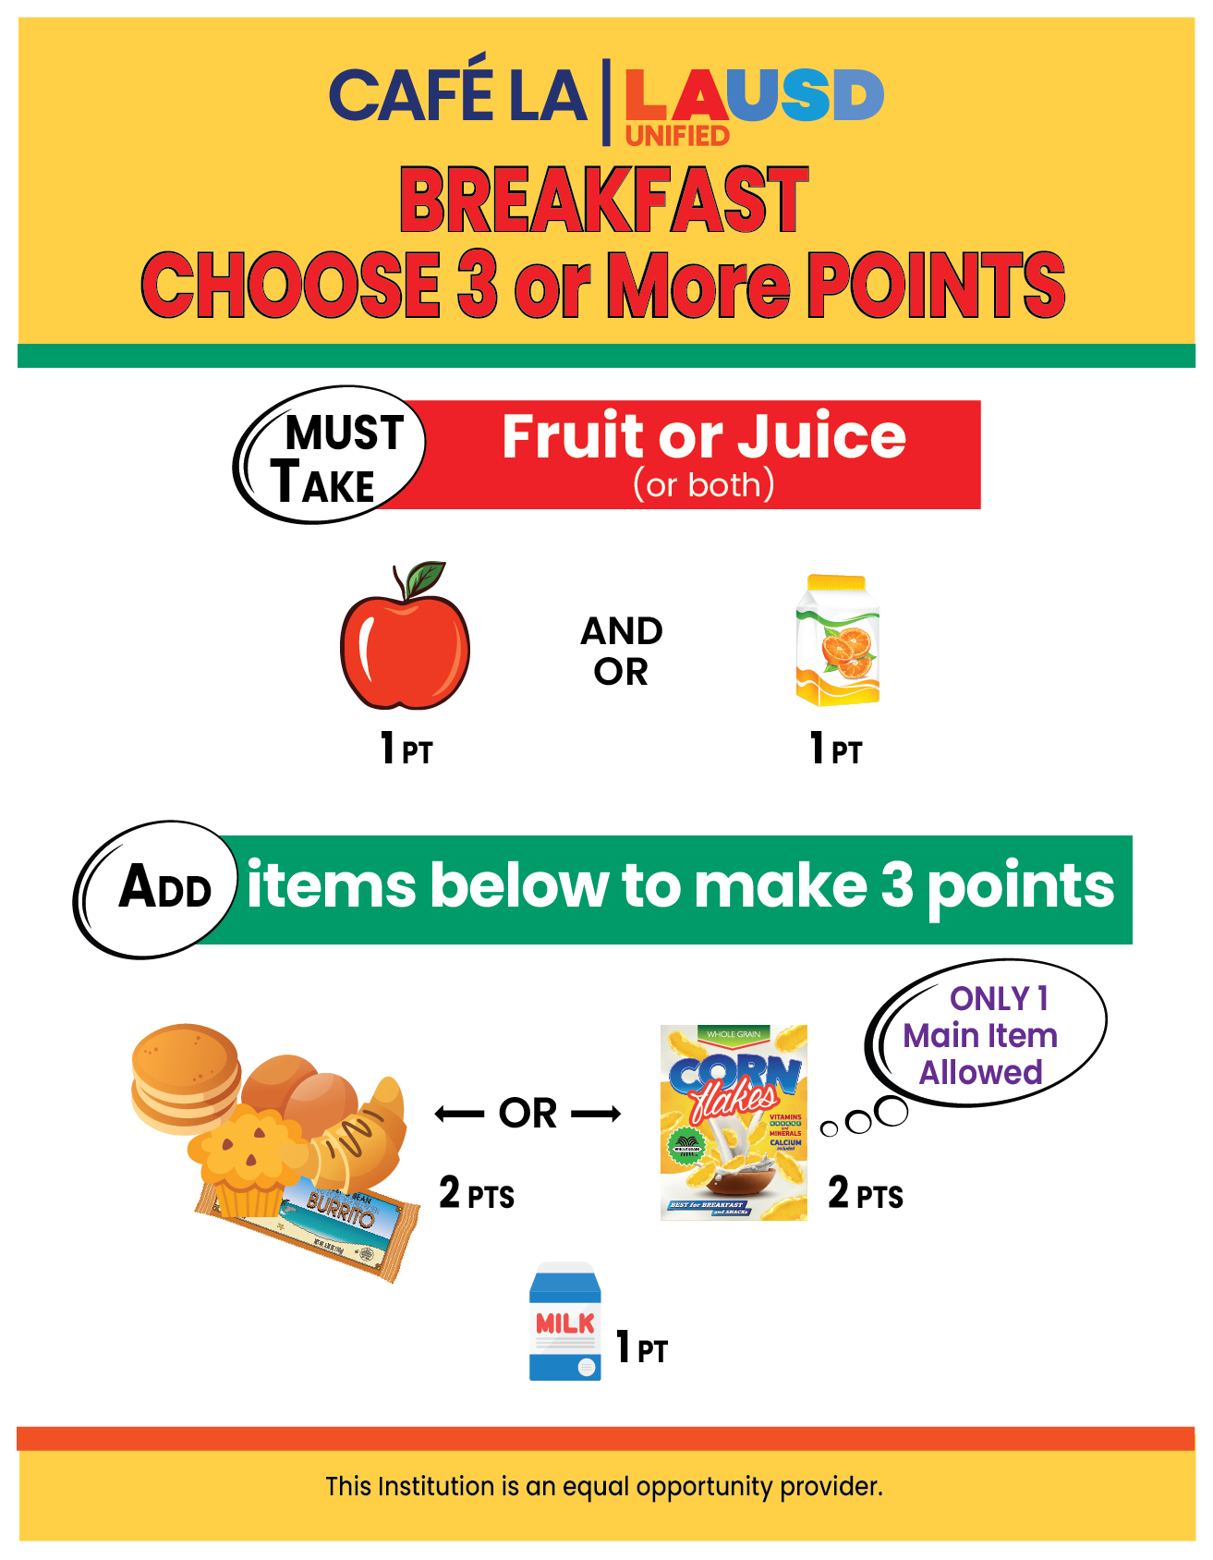

Slide 22
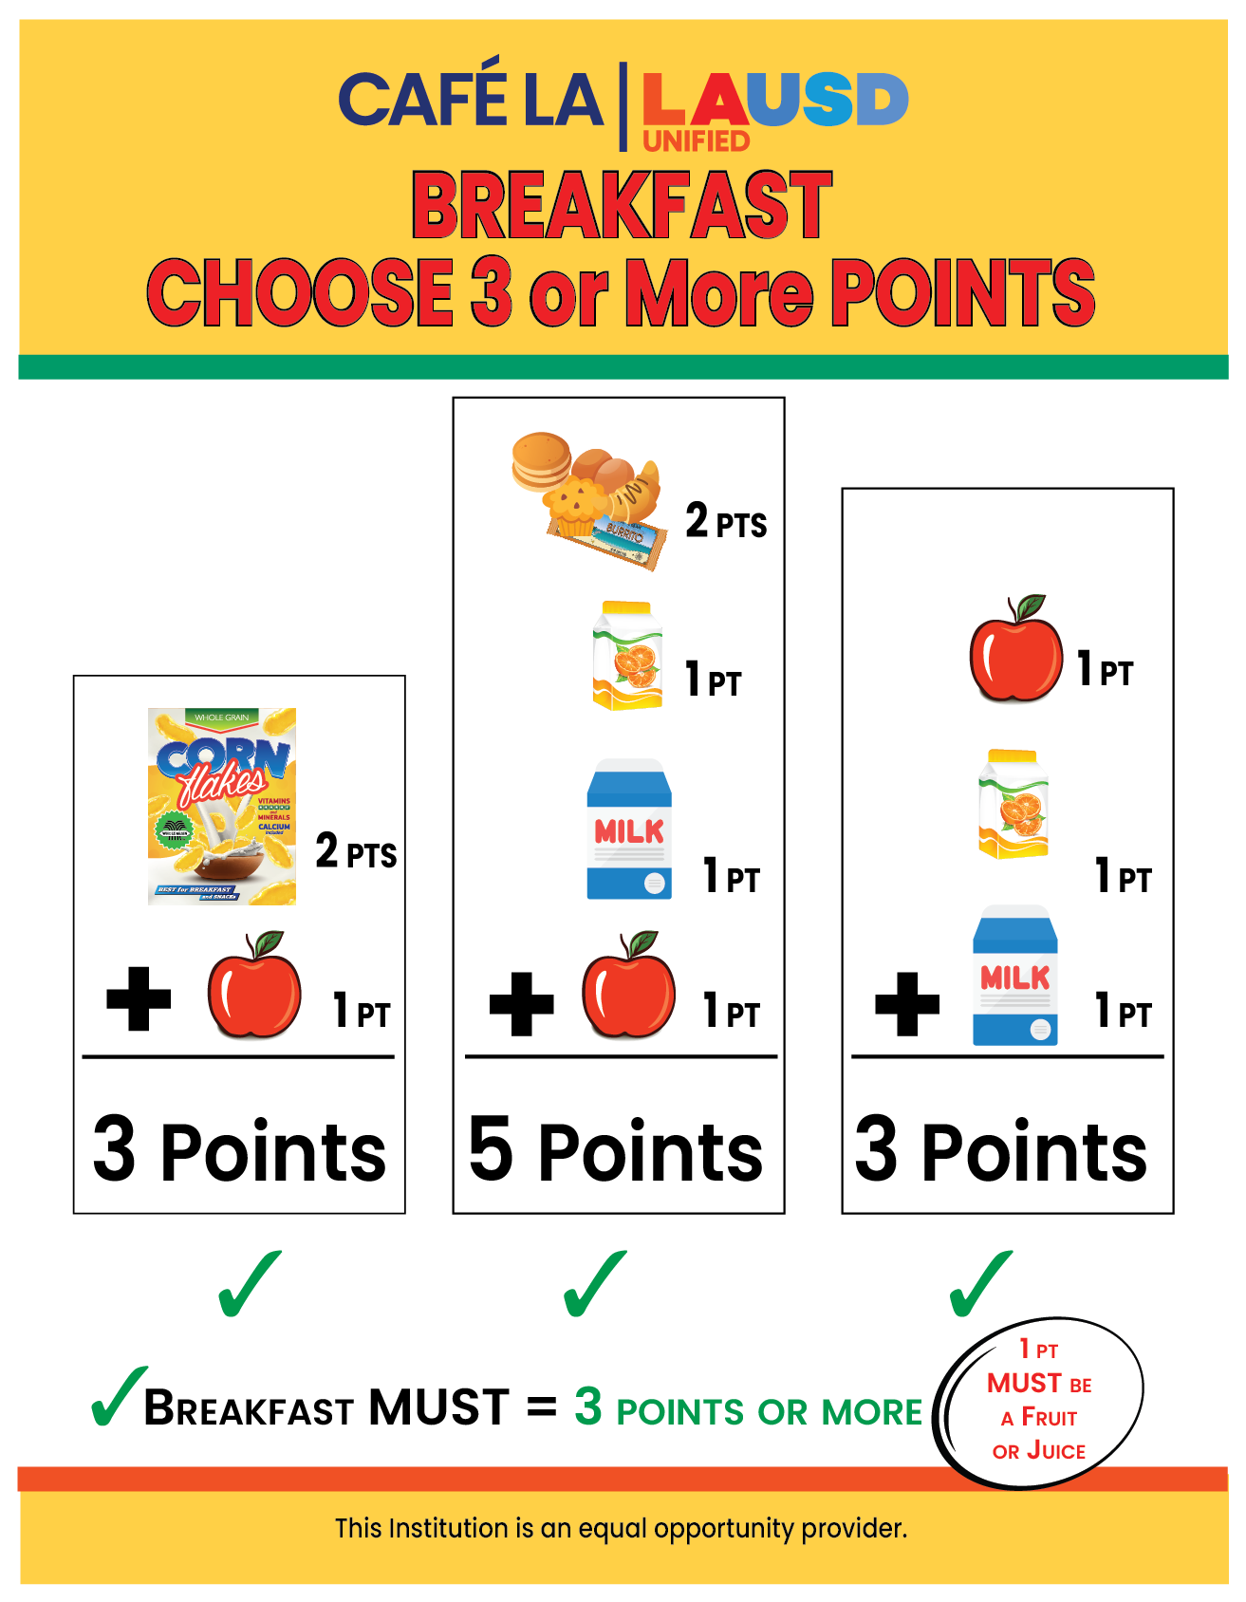

Slide 23


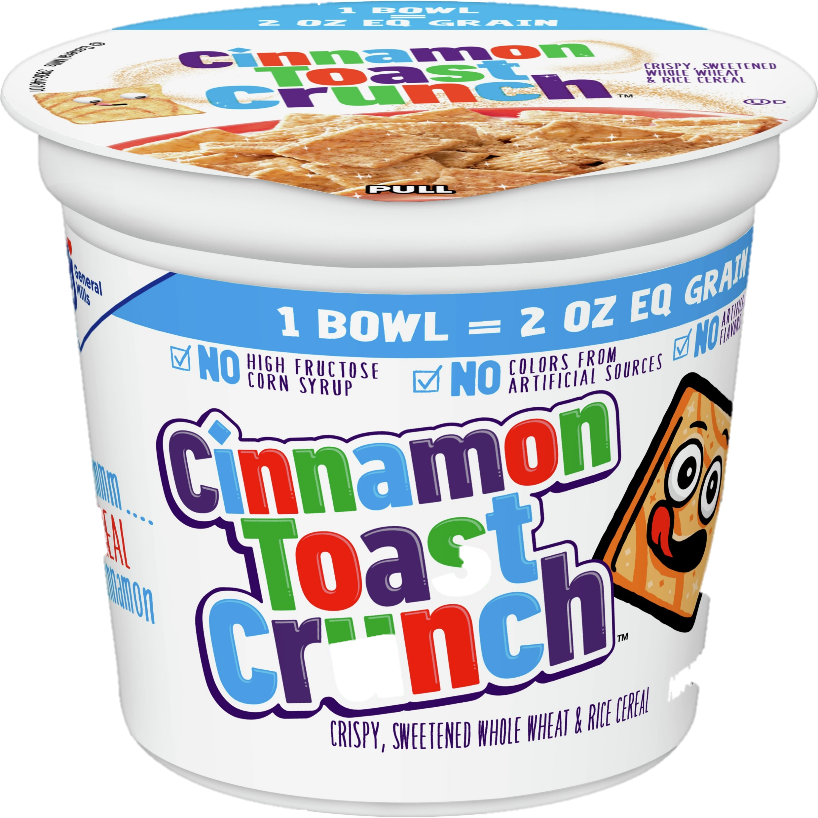




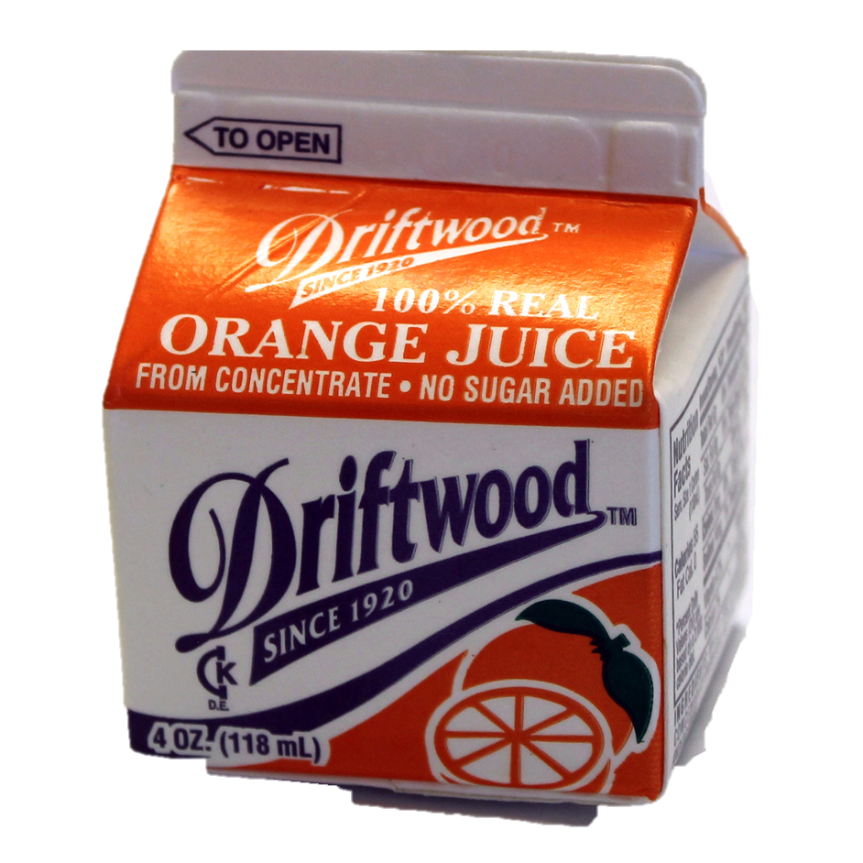
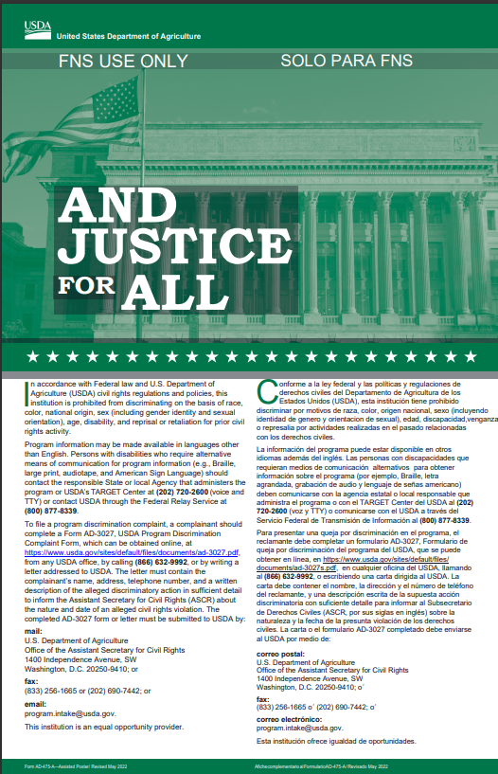
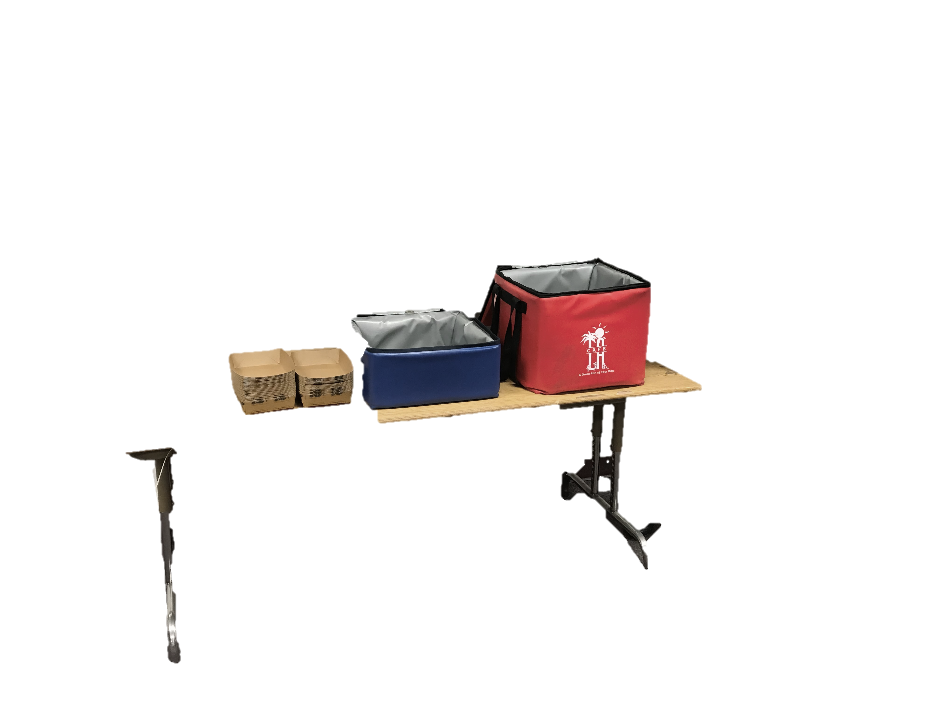
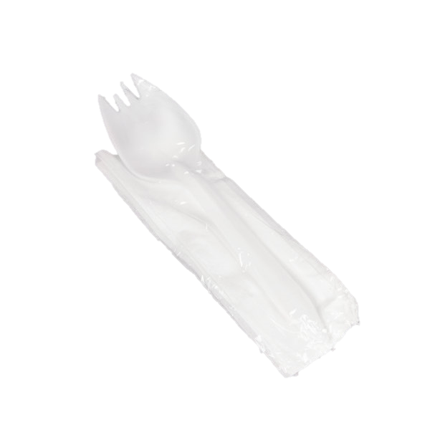
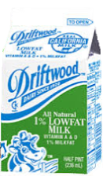

And they can always take another food item
Main Item is 2 points
Students must take a total of 3 points
Fruit juice is 1 point
+
+
1 point
2 points
1 point
Notes:
We are going based off a point system for breakfast offer versus. Students must take a minimum of 3 points for it to be a full reimbursable meal. Every main item or food item is 2 points.
STUDENTS MUST TAKE 3 POINTS:
Take no more than 1 food/main item
One item must be fruit or juice

Slide 24
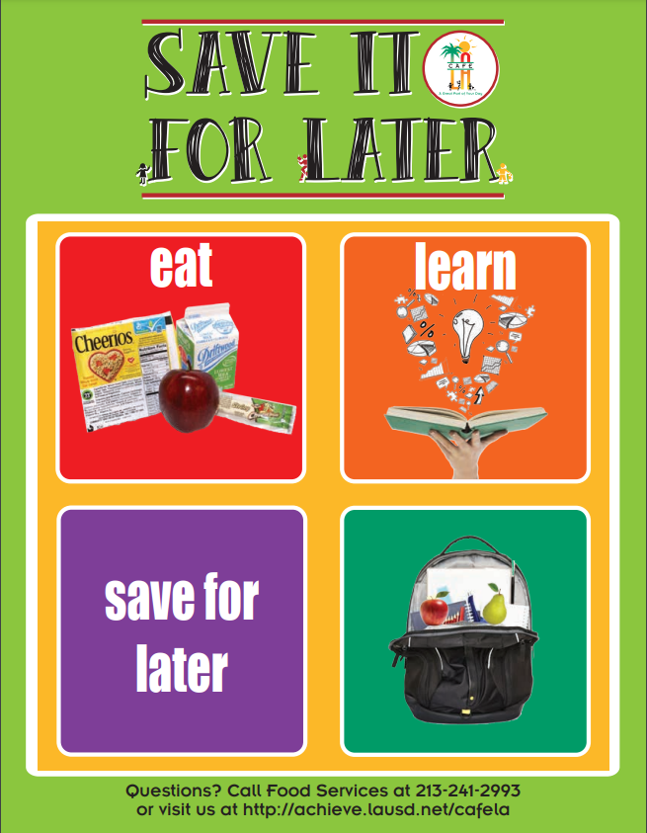

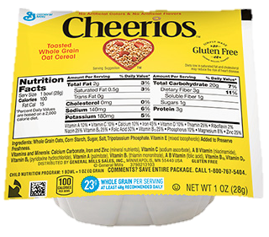
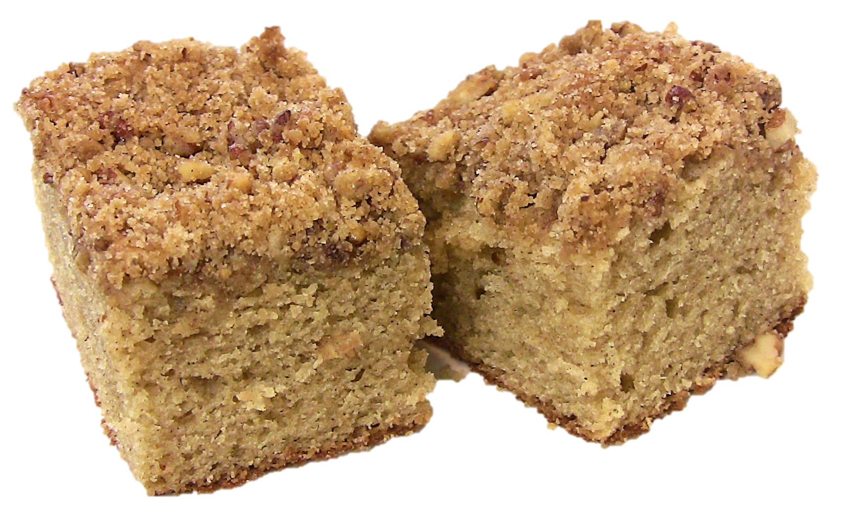
Not Too Hungry… Save it For Later!
A student may want to save a food item to eat later during the day. This is allowable if the food item is not perishable and/or needs refrigeration.
Potentially hazardous food may not be saved, such as: milk, cheese, items with meat
Notes:
TELL: Did you know that students can save some items for later? Everyday, students can save fruit to eat later after breakfast, and as long as it is not open, fruit cups, cereal, and delicious coffee cake are also included. We must have this mandatory poster updated it is no longer the save it for later alligator posters.
If you see we served breakfast and it is now lunch time and you see a student in your lunch line with milk from breakfast it is your responsibility to protect those students. Ask politely can I go ahead and replace that milk for you the temperature might be a little hot I don’t want you to get an upset stomach.

Slide 25
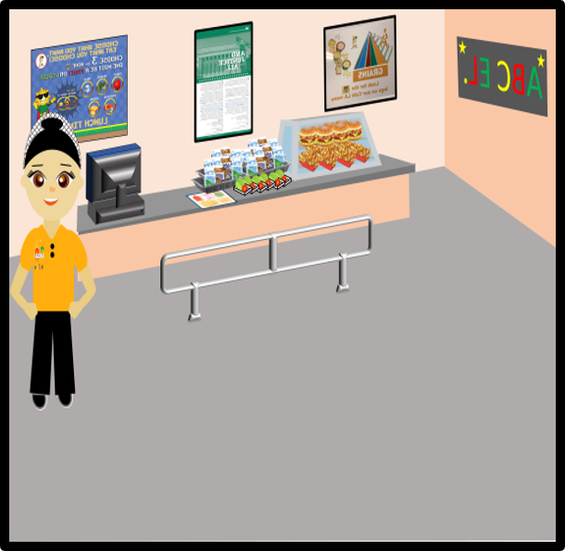
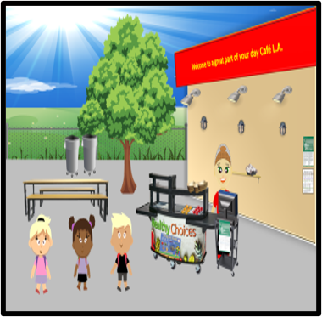
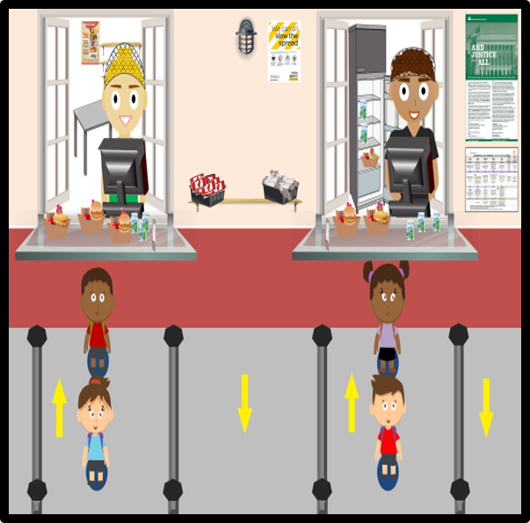
Lunch OVS Rules
Lunch Cart Service
Cafeteria Lunch Service
Window Lunch Service
Notes:
TELL: Who’s getting hungry for lunch? Now that its almost time for lunch, let’s talk about some lunch rules!

Slide 26
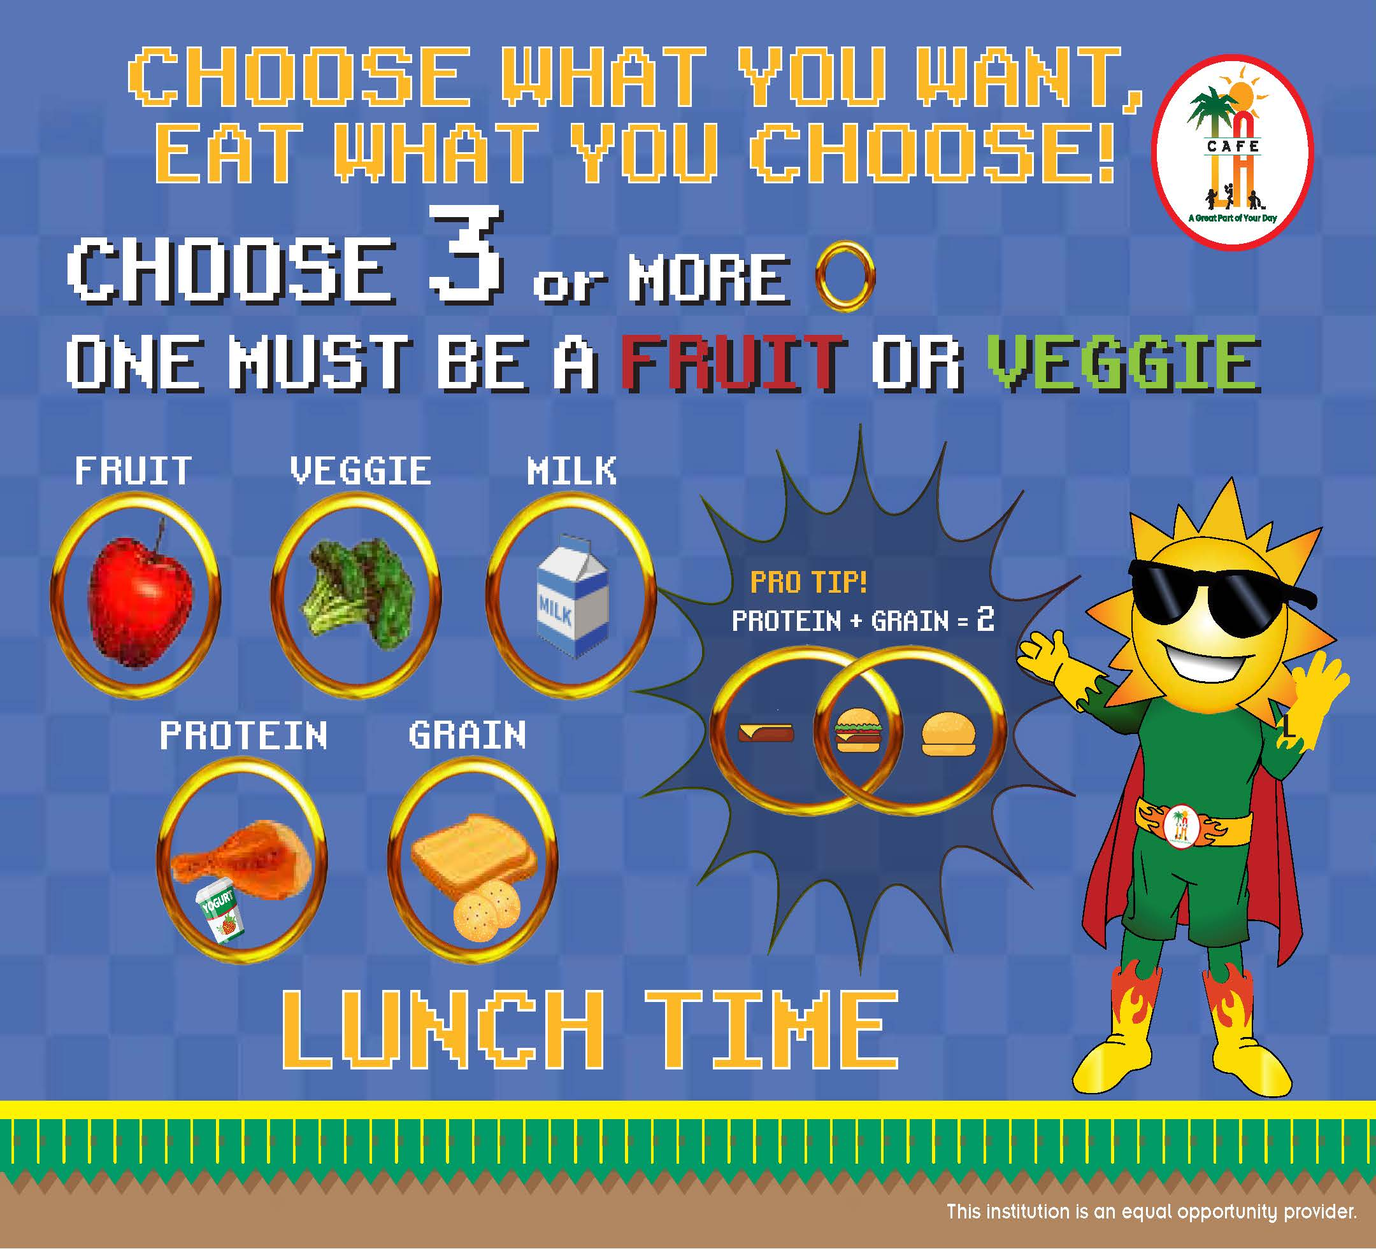
Notes:
READ: The Café LA Lunch sign is designed to facilitate the process of assembling a reimbursable meal by placing different colored star symbols to distinguish the different food components as well as the minimum selection requirements. Signage should be near the beginning of the serving line to help students select a reimbursable meal before reaching the POS.

Slide 27

Remember, students DO NOT have to take all the food offered during lunch.
1 component
must be a
?
They must take
at least
Fruit
or
Vegetable
3
components
Notes:
Students do NOT have to take all items offered. The magic number to remember is 3. 3 components from lunch must be selected.

Slide 28
1 of the 3 components must be a
½ cup of fruit or ½ cup of vegetable.
OR
Notes:
TELL: The rules of lunch are the students must select at least 3 components for lunch. 1 must be a ½ a cup of fruit or a1/2 a cup of vegetable.

Slide 29

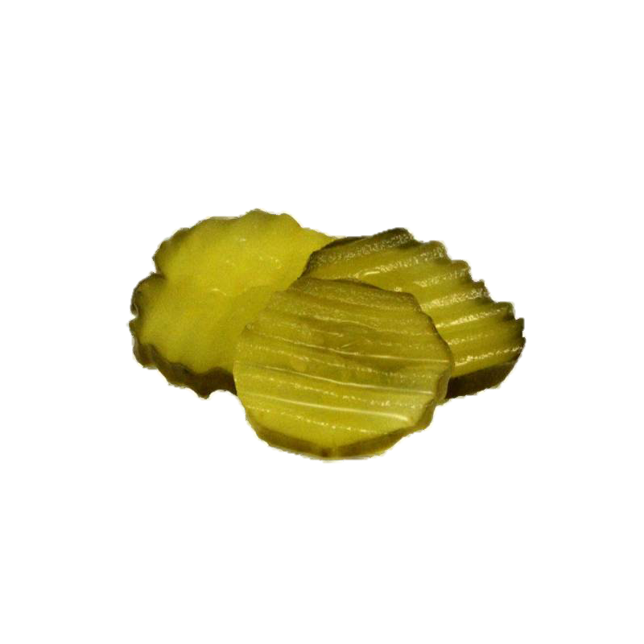

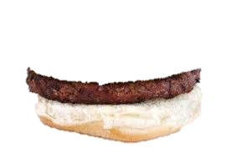

1 Entrée = 2 or more components
Entrees
Hamburgers have how many components?
Notes:
TELL: Some menu items will consist of 2 components or more (2 stars) Let’s break that down. As you can see here this burger has 2 components. The burger has the grain component and the hamburger patty contributes to the meat/meat alternative component. All they are missing for a full reimbursable meal is a fruit or vegetable.

Slide 30

Pizza has how many components?
Notes:
On this next slide can you tell me how many components is this menu item and why?
This pizza is 2 components that consists of the grain for the crust and the meat/meat alternative for the cheese and pepperoni.

Slide 31
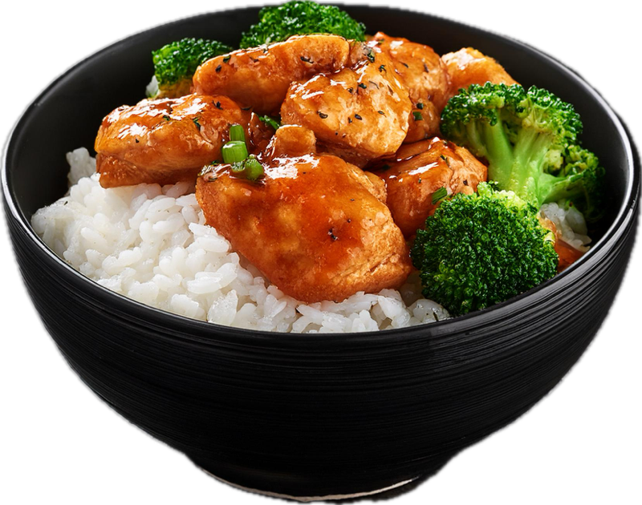
Orange chicken bowls have how many components?
Notes:
Let's go through one more example? Can anyone tell me how many components is this menu item and why?
This menu item is 3 meal components the rice is the grain, the chicken is meat/meat alternative, and the broccoli is ½ cup of vegetable.

Slide 32
Some entrees have vegetables that may or may not meet the ½ cup requirement in order for it to be a reimbursable meal.
Notes:
Make sure you are reading the meal contribution list and recipe to see if the vegetable meets the ½ cup reimbursable meal requirement.
Using the meal contribution list can you tell me which of these items does not have a ½ cup of vegetable?

Slide 33
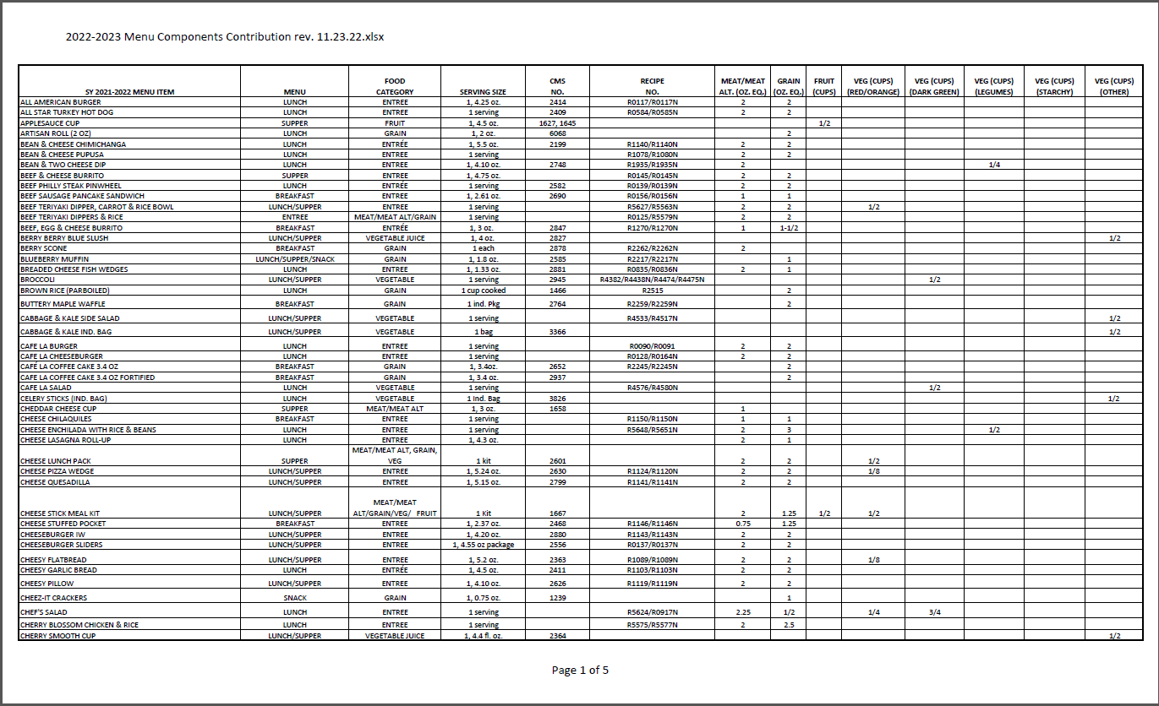
Menu Contribution List
When making substitutions to the menu, refer to the Menu Contribution List to ensure the meal pattern requirements are met.
2024-2025 Menu Components Contribution
Notes:
The menu contribution list will give you the serving amount for each item/ compinent a student needs based on their age, grade, and standard set by the U.S.D.A. This is the reason it is important food service staff follow the recipes set forth, when preparing and serving meals. This ensures each student is getting the proper nutrition to achieve excellence in the L.A.U.S.D. In addition, if you need to make substitutions for any items you can

Slide 34






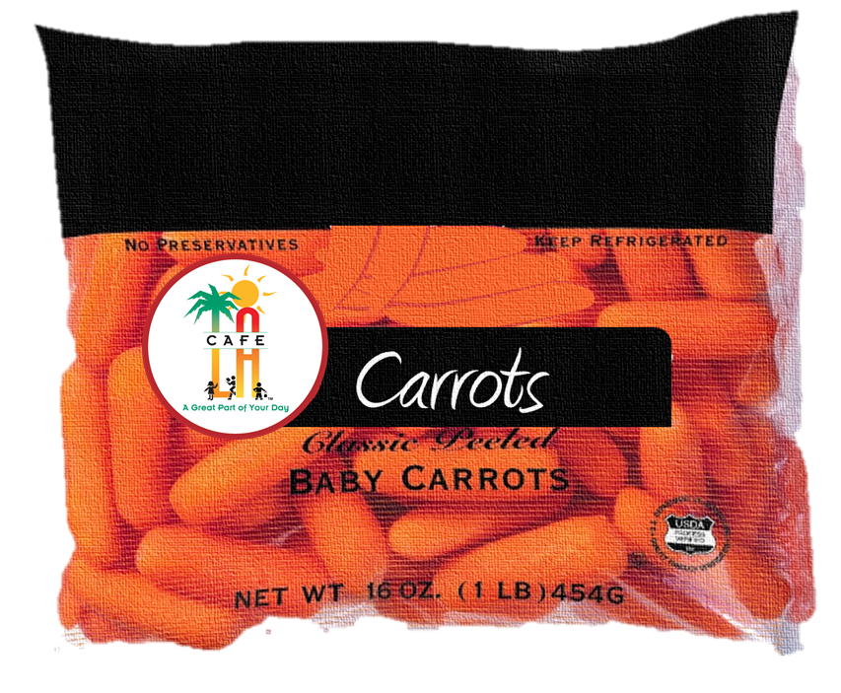
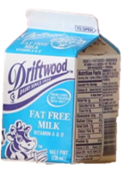
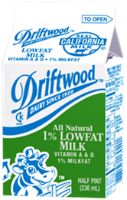
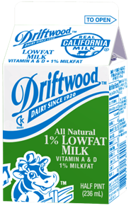
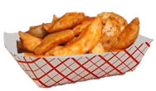
Is this a reimbursable meal?
Today’s Menu
Yang’s Orange Chicken Bowl
Toasted Cheese Sandwich
Potato Wedges
Baby Carrots
Fresh Fruit
Milk
Notes:
Activity: As the child moves through the line, he/she will pick up the items they will like for lunch. Does their selection complete a reimbursable meal?
Click through activity to continue with audience participation out loud.

Slide 35


Is this a reimbursable meal?
Today’s Menu
Yang’s Orange Chicken Bowl
Toasted Cheese Sandwich
Potato Wedges
Baby Carrots
Fresh Fruit
Milk
Notes:
Activity: As the child moves through the line, he/she will pick up the items they will like for lunch. Does their selection complete a reimbursable meal?
Click through activity to continue with audience participation out loud.

Slide 36
Is this a reimbursable meal?
What item will complete the meal?
Today’s Menu
Yang’s Orange Chicken Bowl
Toasted Cheese Sandwich
Potato Wedges
Baby Carrots
Fresh Fruit
Milk
Notes:
Activity: As the child moves through the line, he/she will pick up the items they will like for lunch. Does their selection complete a reimbursable meal?
Click through activity to continue with audience participation out loud.

Slide 37
Chapter 3
The
Menu

Slide 38
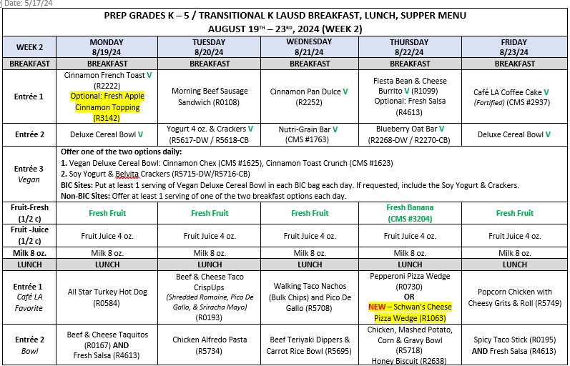
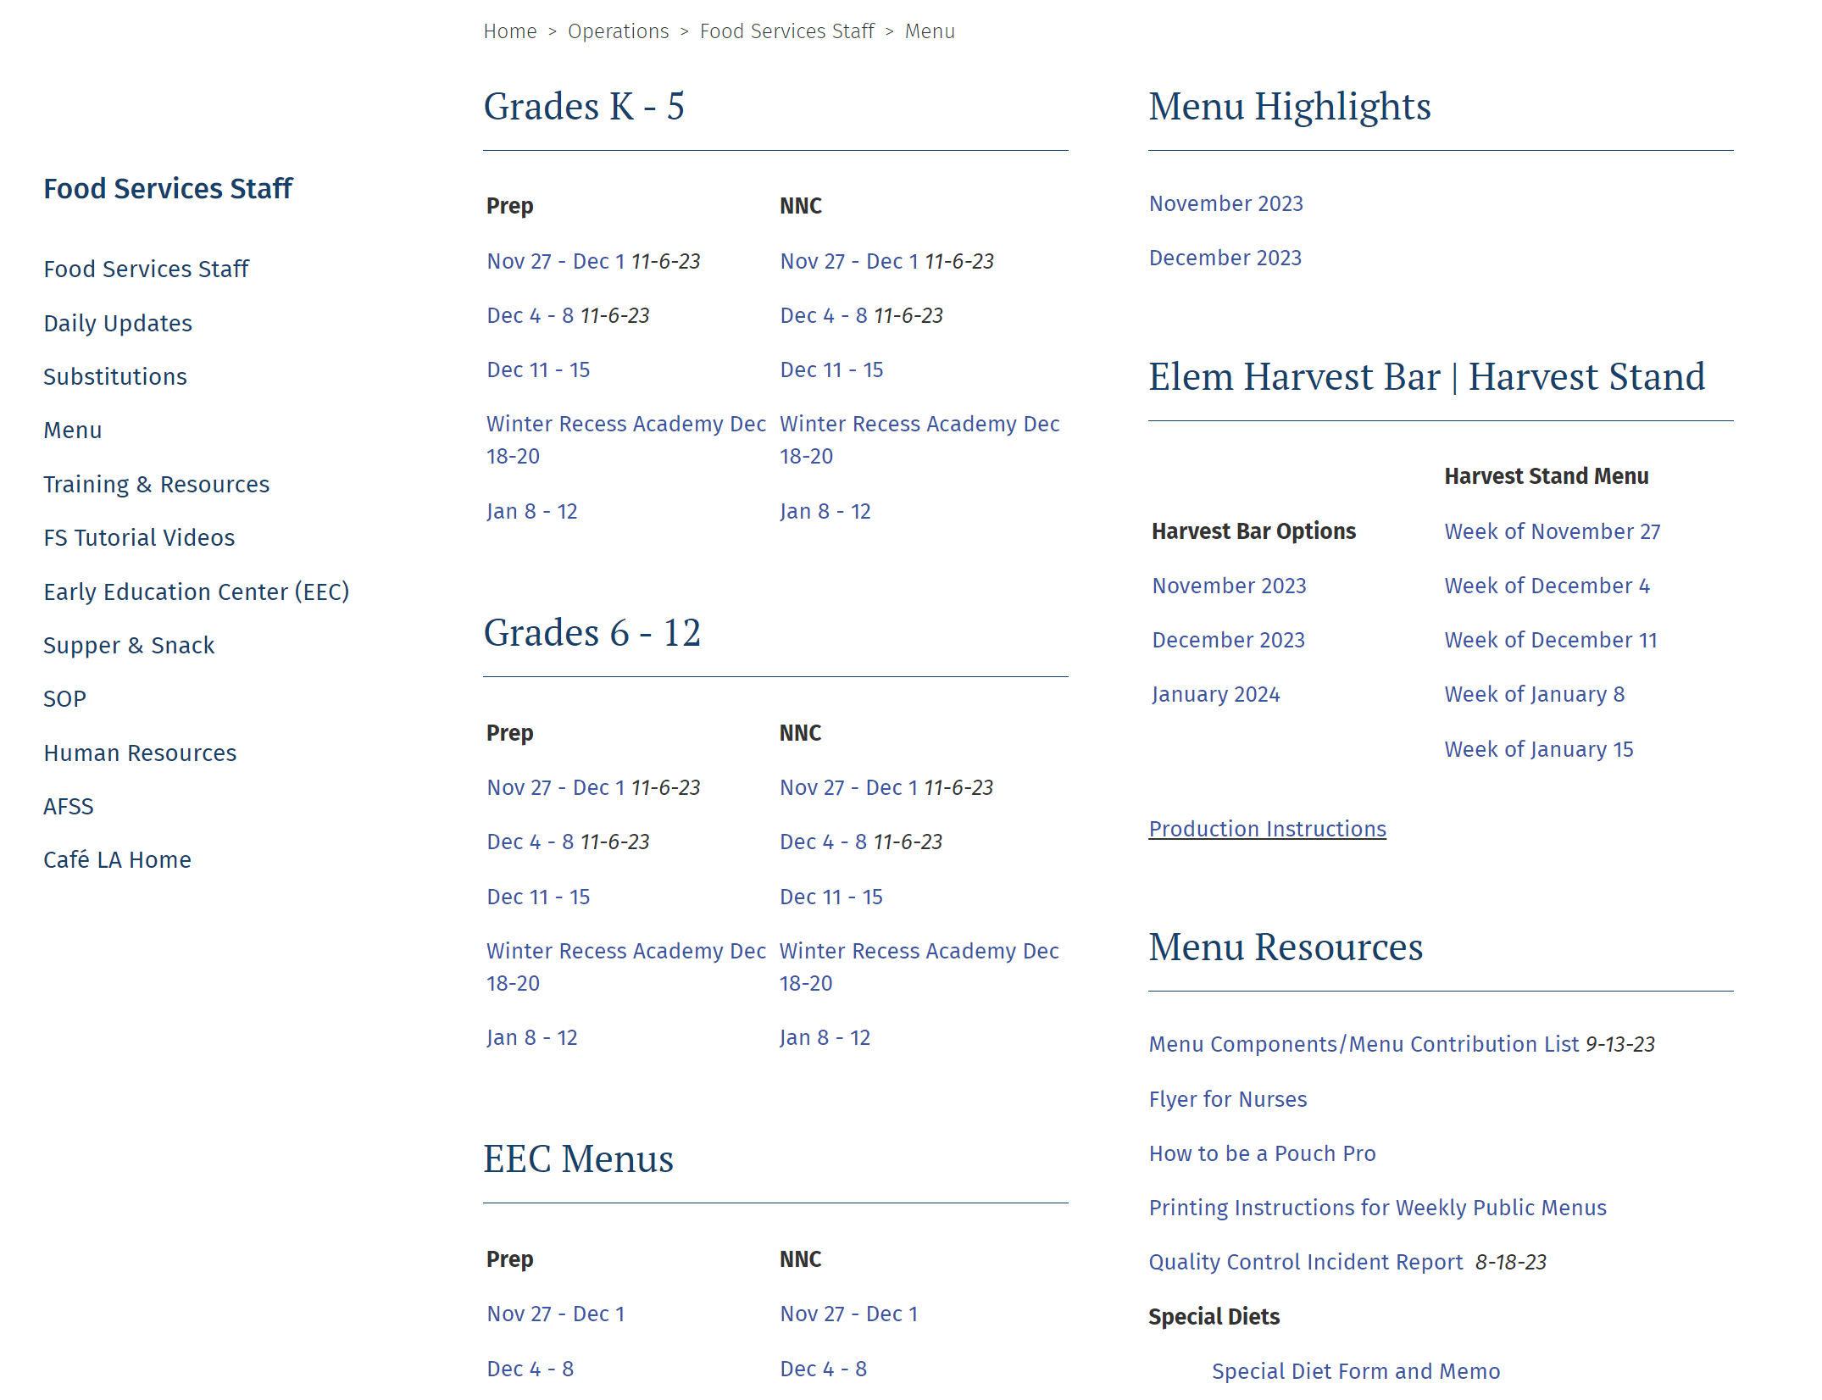
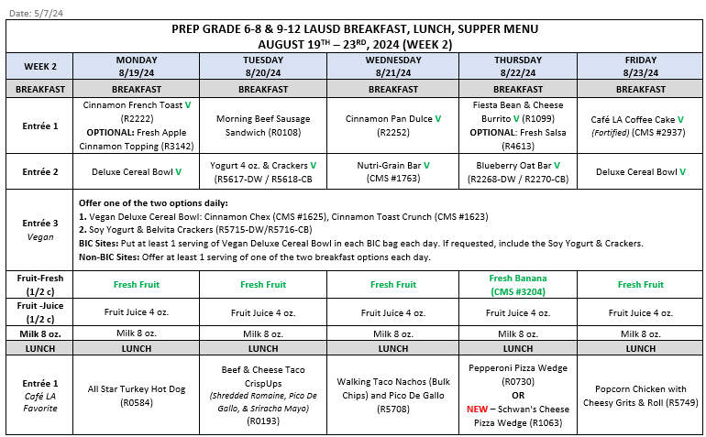
Where Are Menus Located?
K-5th Grade Menu
Follow the correct
Service Type and Grade Level for your site.
(6th-12th ) Grade Menu
Menus are located on the Café LA Website>“Menu” tab.
Notes:
Where are menus located? Back of the house menus are located on the Café LA Website under the menus tab. You will log in using your username and password into the internal users website then click the menus tab. When you click on the menus tab you will see menus are separated by grade for K-5, and Grades 6-12. Always make sure you are using the correct menu for your site to ensure you are following the correct meal pattern.

Slide 39
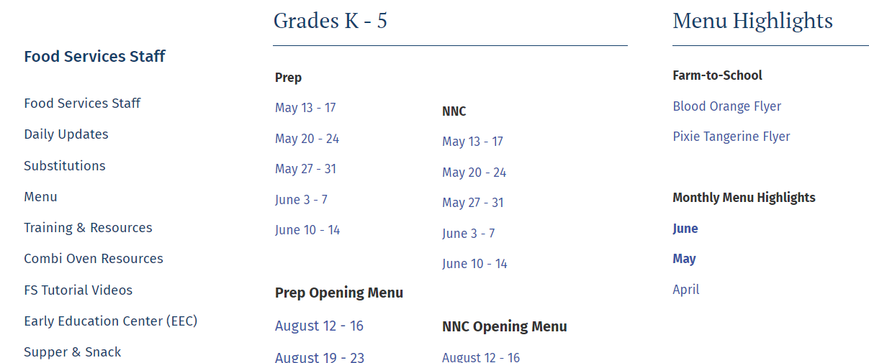
Monthly Menu Highlights
Updates on new menu items as well as the harvest of the month is available on the Monthly Menu Highlights on the top right side of the Menu tab.
Notes:
Menu are located on the Café LA website? Click on “Menu tab” Always check to select and print out the correct grade level and service type menu.

Slide 40
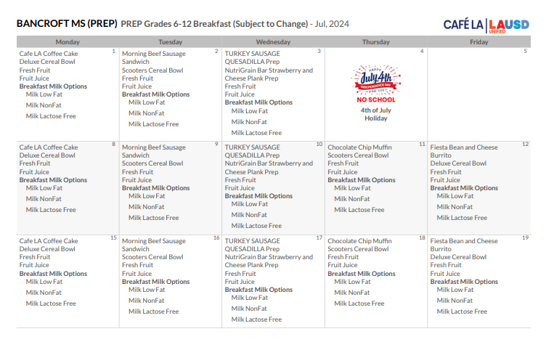
Public Menu
Menus for public posting are available on the YumYummi App.
Printing instructions and QR codes are located on the FSD website under the Training & Resources tab.
Notes:
Use the YumYummi App to print out public menus for your customers. You can locate the YumYummi App and resources on how to use the app, on the Food Services Training Website. Log into LAUSD Food Services Internal Website using your LAUSD single sign on and password. Select Training Resources Tab > Then scroll down to the Section YumYummi App. Once there you will find instructions on how to print menus using the Yumyummi app and QR codes that take you directly to the menus.

Slide 41
Tips for Reading the Menu
Chapter 4
Notes:
Lastly we will be covering tips for reading the menu.

Slide 42
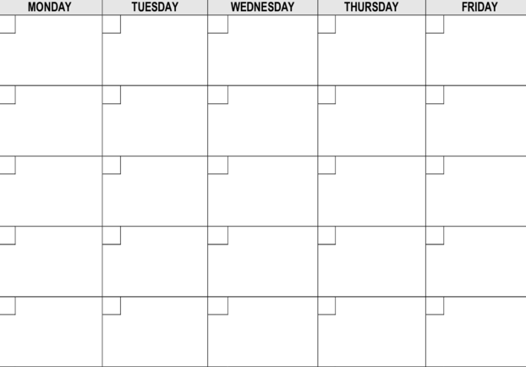
Key Words & Symbols
What Does This All Mean?
Or =
*
*
&, And =
Optional =
V
*
Notes:
The training team sat down with the menu team to discuss what do we want the managers to get out of the menus when reading them. Of course they need to follow the menus when forecasting and preparing meals to ensure the meal pattern is being followed but we want to make sure we understand what these menus are telling us. So lets get started.

Slide 43
Key Words & Symbols
Tip Sheet
WORD OR SYMBOL | DEFINITION
OR | Manager has the flexibility to choose which entrée to prepare/offer from the menu.
& | Side item and entrée are bundled and served together.
WITH or W/ | Side item and entrée are bundled and served together.
OPTIONAL | Manager has choice to prepare/offer or not to prepare/offer that item.
* | Fresh Topping: The menu will indicate if the Fresh Topping is optional or mandatory to serve with the entrée. The Fresh Topping options include Fresh Pickles, Fresh Lettuce, or Sandwich Set-up.
** | Manager’s Choice
V | Food item is vegetarian
AND/OR | Manager can choose to prepare/offer either or both entrees on the menu.
Notes:
So, first off, we want to look at the key words that are on the menus. This keywords and symbols tip sheet is available of the Cafe LA website under the menus tab. You can print and post this resource to refer back to if needed.

Slide 44
&
“&” indicates side item and entrée are bundled and served together.
Zesty Beef Chalupa, Bulk & Tortilla Chips (R5699) AND Fresh Salsa (R4613)
NEW-Pork Carnitas Bowl (Mexican Brown Rice, Seasoned Pinto Beans, & Pico De Gallo)
Beef Teriyaki Dipper
& Carrot Rice Bowl
(R5627)
Banh Mi Sandwich w/Pickled Carrots & Daikon (R5753)
Vegan Teriyaki
& Carrot Rice Bowl (R6041)
Notes:
“And (&)” indicates the side item and entrée are bundled and served together. It comes together as one item so when assembling it will be assembled all together it is married.

Slide 45
OR
“Or” indicates the manager has the flexibility to choose the entrée on the menu.
To increase meal participation and gain customer satisfaction, select the most popular menu item.
Pepperoni Pizza Wedge
(R0730)
OR
NEW – Schwan’s Cheese
Pizza Wedge (R1043)
Chik’n Nuggets (R6021)
Artisan Roll (CMS #6068)
OR
Buffalo Chik’n Nuggets
(R6031)
Artisan Roll (CMS #6068)
Notes:
This is a sample from the menu of how OR would be used in the menu. Or gives managers the choice to serve items based on your students' preferences.

Slide 46

AND/OR
Manager can choose to prepare/offer either
or both entrees on the menu.
Notes:
This is a sample from the menu of how AND/OR would be used in the menu. AND/OR gives managers the choice to either/or or both items this gives our students more choices.

Slide 47
Optional
“Optional” indicates the manager has the choice to prepare/offer or not to prepare/offer that menu item.
Cinnamon French Toast V
(R2222)
OPTIONAL: Fresh Apple
Cinnamon Topping (R3142)
Notes:
Optional items will clearly indicate that it is optional. Optional indicates the manager has the choice to prepare/offer or not to prepare/offer that menu item. For example, cinnamon French toast has an option to prepare the fresh apple cinnamon topping with the French toast. The Cinnamon French Toast is not optional you must serve the French toast if that’s the entrée you choose when forecasting but it is optional whether you will serve the fresh apple cinnamon topping. This option will be based off your students' preferences. If your students prefer their Cinnamon French Toast with the Fresh Apple Cinnamon Topping then make sure you are offering that option. If you see after a while they aren’t taking it anymore you can choose to stop offering that option.

Slide 48

Asterisk Symbol
*
=
Single asterisk specifies a Fresh Topping. Refer to the menu to determine if the item is optional or mandatory.
*FRESH TOPPING: SERVE EITHER FRESH PICKLES (R4618) OR LETTUCE (R4642) OR
LETTUCE & TOMATO (R4520)
*
*
=
Double asterisk refers to Managers Choice menu item.
Managers Choice**
Sandwich
Smoothie
Parfait
Notes:
Now let’s look at the asterisk symbol when reading the menu. If you see a single asterisk with a burger or sandwich meaning this burger or sandwich comes with a fresh topping choice. When you read the key on the menu it will give you the option to serve either Fresh Pickles, Lettuce, or Lettuce & Tomato with your burger or sandwich. Whether this is mandatory or optional will be indicated on the menu. Out of the 3 options if you refer to the menu contribution list the only item that is a full ½ cup vegetable is the lettuce & tomato the fresh pickles and lettuce are only a topping.
If you see a double asterisk this refers to managers choice menu item. This applies to sandwich choice, smoothie choice or parfait choice. So this give you more options to serve your students the menu items they prefer. Remember we want to serve our students what they like to keep participation up.

Slide 49
Vegan
Vegan will have its own row on the menu for breakfast, lunch, and supper.
Vegan options must be offered for breakfast and lunch. The supper vegan option is upon request.
Entrée 3
Vegan
Impossible Burger*
(R6032) AND
Fresh
Topping+
Vegan Teriyaki & Carrot
Rice Bowl
(R6041)
Vegan Chick’n Tenders
(R6043)
Artisan Roll (CMS #6068)
Notes:
As you may have seen on the menus Vegan entrees will have its own row on the menu. We serve vegan options daily for breakfast and lunch that is why it will have its own place on the menu. Here are some examples of vegan lunch entrees we serve.

Slide 50
Vegetarian Symbol
V
=
Specifies the food item is a vegetarian option.
Cinnamon French Toast V
(R2222)
OPTIONAL: Fresh Apple
Cinnamon Topping (R3142)
Notes:
Next to each entrée a V will indicate the item is vegetarian. Remember a vegetarian can eat a vegan entrée however a vegan can not eat a vegetarian option because it may have cheese in it. Vegans eat nothing with animal by product. Vegans cant eat vegetarian

Slide 51


Salad Entrée
The entrée salad and roll are not bundled together.
The grain component is Offer Vs Serve.
The servings of salads and rolls will or will not match.
C
Chicken Parmesan
Salad
(R5710)
Cheesy Garlic
Breadstick
(R2657)
Cajun Chicken Salad
(R5713)
Cajun Ranch
Dressing
Honey Biscuit
(R2638)
Chinese Vegan
Chik’n Salad
(R6039)
Artisan Roll
(CMS #6068)
Chinese Chicken Salad
w/Shredded Chicken
(R5709)
Hawaiian Roll
(CMS #6082)
Notes:
Keep in mind when it comes to salad entrees if the salad entrée and the grain component have different recipe and stock numbers this indicates that it is NOT bundled together. There is no AND or & Symbol meaning they are not bundled the bread is offer vs serve. Offer the bread with the salad based on your students' preferences. It must be offered but it is not mandatory for students to take the bread with the salad for that reason it is not bundled. For example the Cajun chicken salad has its own recipe number and the honey biscuit has its own stock number this means it is bundled I may prepare more salads and less biscuits. On the other hand chicken parmesan salad is offered with cheesy garlic breadstick but it is not bundled but I know my students will like the breadstick so I will make sure to prepare enough of both items because I have to make sure not to run out.

Slide 52
Bread Items
Bread items with a recipe or stock number are not bundled with the entrée.
These bread items do not have an “AND” indicating they are bundled with the entrée.
These items follow Offer Versus Serve (OVS) guidelines.
Chicken, Mashed Potato,
Corn & Gravy Bowl
(R5718)
Honey Biscuit
(R2638)
Beef Teriyaki Dipper &
Carrot Rice Bowl
(R5627)
Chik’n Nuggets (R60210)
Artisan Roll (CMS #6068)
Carnitas Bowl (Pork, Rice,
Beans)
(R5649)
Notes:
Same as the salad entrée and grain component being offer versus serve the same applies to other menu items with bread as a side. As we said earlier if there are different recipe and stock numbers and no and symbol this indicates it is Offer Versus serve it must be offered but does not have to be served students don’t have to take it. For example Chikn Nuggets and Artisan Roll both these items have two different numbers so I wont bundle them I will offer it but students are not forced to take it. Chikn Nuggets are a popular item at Happy elementary so I will prepare 100 servings of Chikn Nuggets but based on my students preferences I will only offer 50 servings of the artisan roll because not every student who takes chikn nuggets takes the roll with it. I want to offer enough rolls without running out while at the same time not staying with too many rolls on hand because I want to reduce waste and I don’t want to waste productivity time but preparing excess of items that are not needed.

Slide 53



Smoothie/Parfait Entrées
Smoothie and Parfait entrees are not bundled with the grain component. The grain component is OVS.
The servings of entrée and grain may or may not match.
C
Manager’s Choice Smoothie
Granola Cinnamon
(CMS #1501) V
OR
Manager’s
Choice Yogurt Parfait
Granola Cinnamon
(CMS #1501) V
OVS
Notes:
Smoothie and Parfait entrees follow the same rule for the grain component being OVS. They are not bundled with granola they do not need to match. They must be offered but students are not required to take the grain with the smoothie or parfait. Things to remember is serve what your students like. Although items are not bundled, we still have to offer it we can not run out of any item. Part of offer versus serve guidelines every student from the start of service to the end must receive the same or equal.

Slide 54
Thank You
Notes:
Smoothie and Parfait entrees follow the same rule for the grain component being OVS. They are not bundled with granola they do not need to match. They must be offered but students are not required to take the grain with the smoothie or parfait. Things to remember is serve what your students like. Although items are not bundled, we still have to offer it we can not run out of any item. Part of offer versus serve guidelines every student from the start of service to the end must receive the same or equal.

